Slide 1
Computer Lab-VII Information and Cyber Security Prof. Manish Khodaskar

Slide 2
Assignment 1
Write a program in C++ or Java to implement RSA algorithm for key generation and cipher verification

Slide 3
Asymmetric/Public Key Algorithm
Public key algorithms were evolved to solve the problem of key distribution in symmetric algorithms. This is achieved by using one key for encryption and a different but related key for decryption.
These algorithms are designed such that it is computationally infeasible to determine the decryption key given only knowledge of the cryptographic algorithm and the encryption key.
Also in some algorithms, such as RSA, either of the two related keys can be used for encryption, with the other used for decryption.

Slide 4
Steps in Public Key Algorithm
Bob’s Public key Ring
Joy
Ted
Alice Private
Key
Alice
Transmitted ciphertext
Plaintext Input
Plaintext Output
Encryption algorithm
Decryption algorithm
Fig. 1.1: Public key cryptography

Slide 5
Each user generates a pair of keys to be used for the encryption and decryption of messages.
Each user places one of the two keys in a public register or the other accessible file. This is the public key. The companion key is kept private. Each user maintains a collection of public keys obtained from other parties participating in communication.
If A wishes to send a confidential message to B, A encrypts the message using B’s public key.
When B receives the message, B decrypts it using B’s private key. No other recipient can decrypt the message because only B knows B’s private key.

Slide 6
RSA Algorithm
RSA (which stands for Rivest, Shamir and Adleman who first publicly described it), an algorithm for public-key cryptographyinvolves three steps key generation, encryption and decryption.
RSA is a block cipher with each block having a binary value less than some number n. That is the block size must be less than or equal to log2 (n). Encryption &decryption are of the following form, for some plaintext block M and ciphertext block C:
C = Me mod n
M = C^{d}mod n = (Me) ^{d} mod n= M^{ed}mod n

Slide 7
RSA Algorithm (cntd)
Both sender and receiver must know the value of n. The sender knows the value of e, and only the receiver knows the value of d. Thus, this is a public-key encryption algorithm with a public key of PU = {e, n} and a private key of PR = {d, n}. For this algorithm to be satisfactory for public key encryption, the following requirements must meet:
It is possible to find values of e, d, n such that M^{ed} = M mod n for all M<n.
It is relatively easy to calculate Me and C^{d} for all values of M<n.
It is infeasible to determine d given e and n.

Slide 8
Algorithm – Key Generation
The keys (public key and private key) for the RSA algorithm are generated as:
Choose two distinct prime numbers p and q.
For security purposes, the integers p and q should be chosen at random, and should be of similar bit-length. Prime integers can be efficiently found using a primality test.
Compute n = pq.
n is used as the modulus for both the public and private keys
Compute φ(n) = (p – 1)(q – 1), where φ is Euler's totient function

Slide 9
Algorithm – Key Generation (cntd)
Choose an integer e such that 1 < e <φ (n) and gcd (e, φ (n)) = 1, i.e. e and φ (n) are co prime.
e is released as the public key exponent.
e having a short bit-length and small Hamming weight results in more efficient encryption - most commonly 0x10001 = 65537. However, small values of e (such as 3) have been shown to be less secure in some settings.
Determine d = e–1 mod φ(n); i.e. d is the multiplicative inverse of e mod φ(n).
This is more clearly stated as solve for d given (d*e)mod φ(n) = 1
This is often computed using the extended Euclidean algorithm.
d is kept as the private key exponent.

Slide 10
Algorithm - Encryption
Alice transmits her public key (e, n) to Bob and keeps the private key secret. Bob then wishes to send message M to Alice. He computes the ciphertext c corresponding to
C = Me mod n
This can be done quickly using the method of exponentiation by squaring. Bob then transmits C to Alice.

Slide 11
Algorithm - Decryption
Alice can recover M from C by using her private key exponent d via computing
M = C^{d}mod n

Slide 12
Example
Select two prime numbers, p = 17 and q = 11.
Calculate n = pq = 17*11 = 187.
Calculate Ø(n) = (p-1)(q-1) = 16*10 = 160.
Select ‘e’ such that relatively prime to Ø(n) = 160 and less than Ø(n); we choose e = 7.
Determine d such that de ≡ 1 (mod 160) and d < 160. The correct value is d = 23, because 23*7 =161 = 10*16 + 1; d can be calculated using the extended Euclid’s algorithm

Slide 13
Example (cntd)
The resulting keys are public key PU = {7, 187} and private key PR = {23, 187}. The example shows the use of these keys for plaintext input of M=88.
Encryption
Decryption
Plaintext
88
Ciphertext 11
Plaintext
88
88⁷ mod 187 = 11
11²³ mod 187 = 88
PU=7,187
PR=23,187
Fig. 1.2 : Example of RSA.

Slide 14
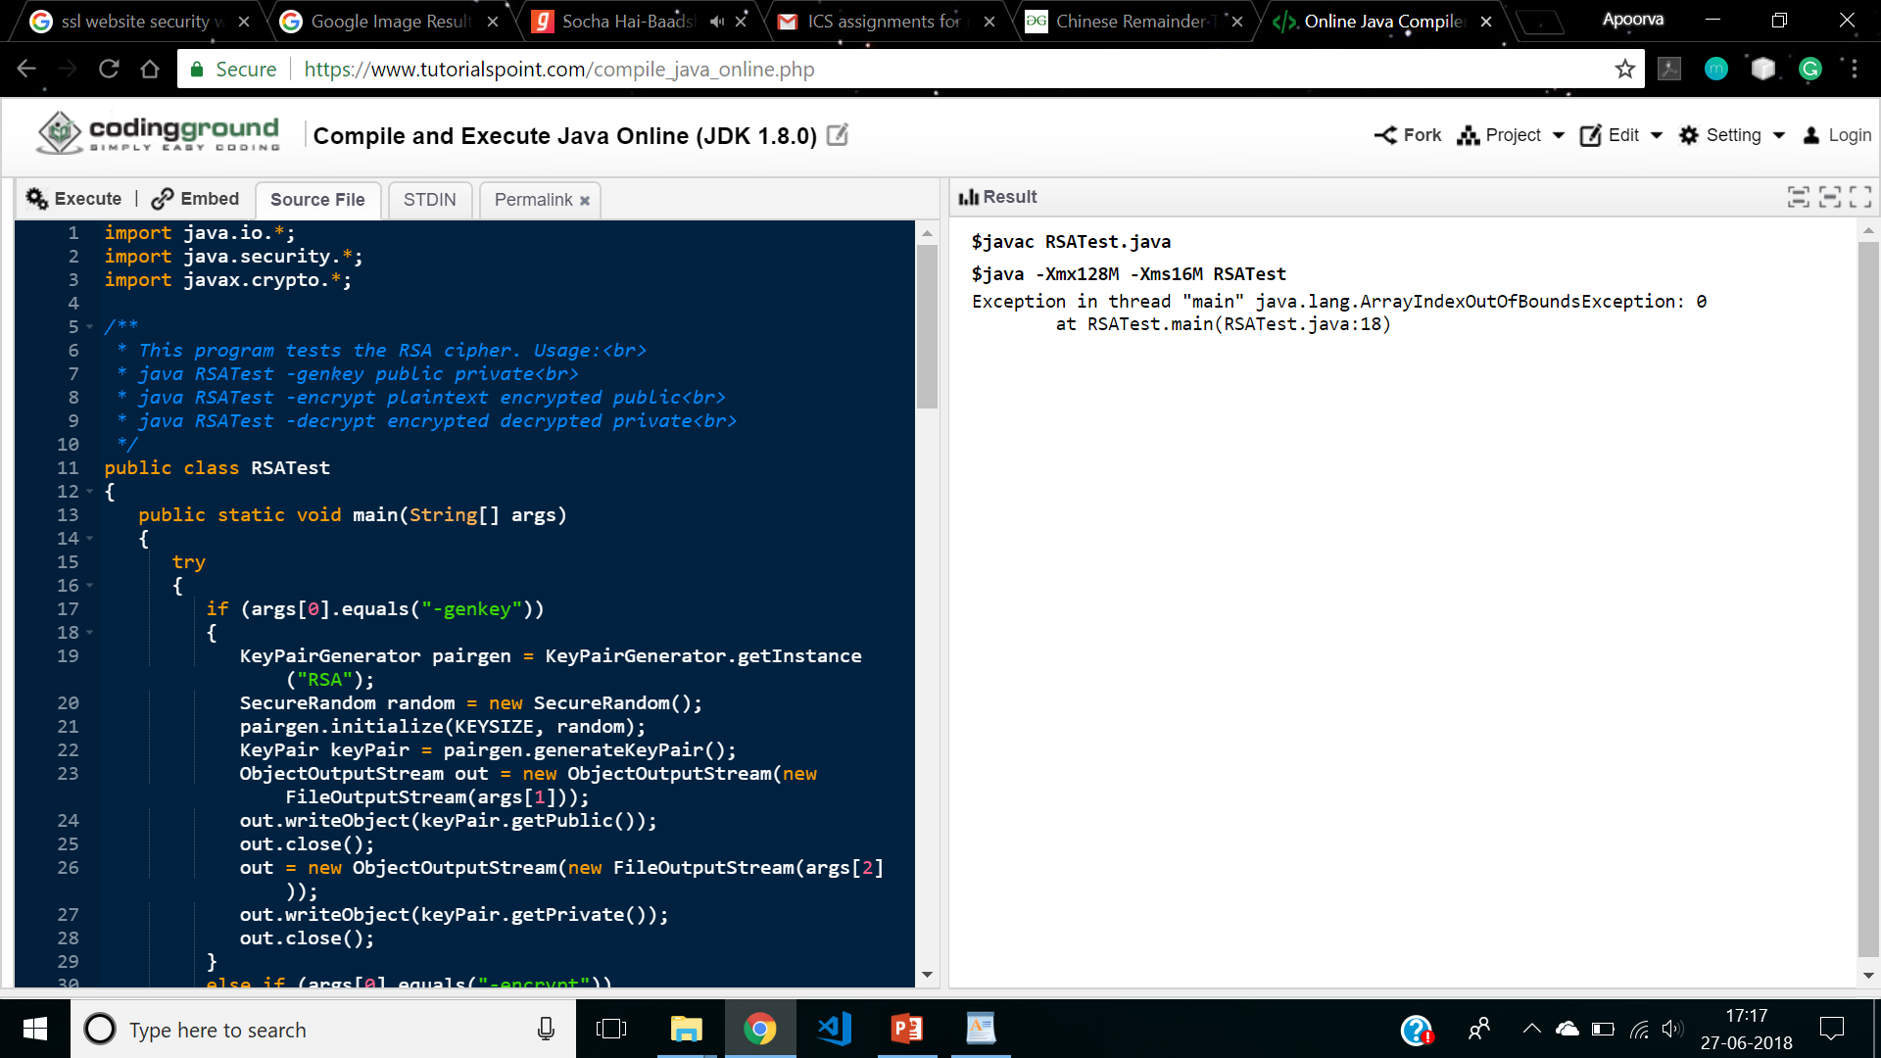
Code

Slide 15
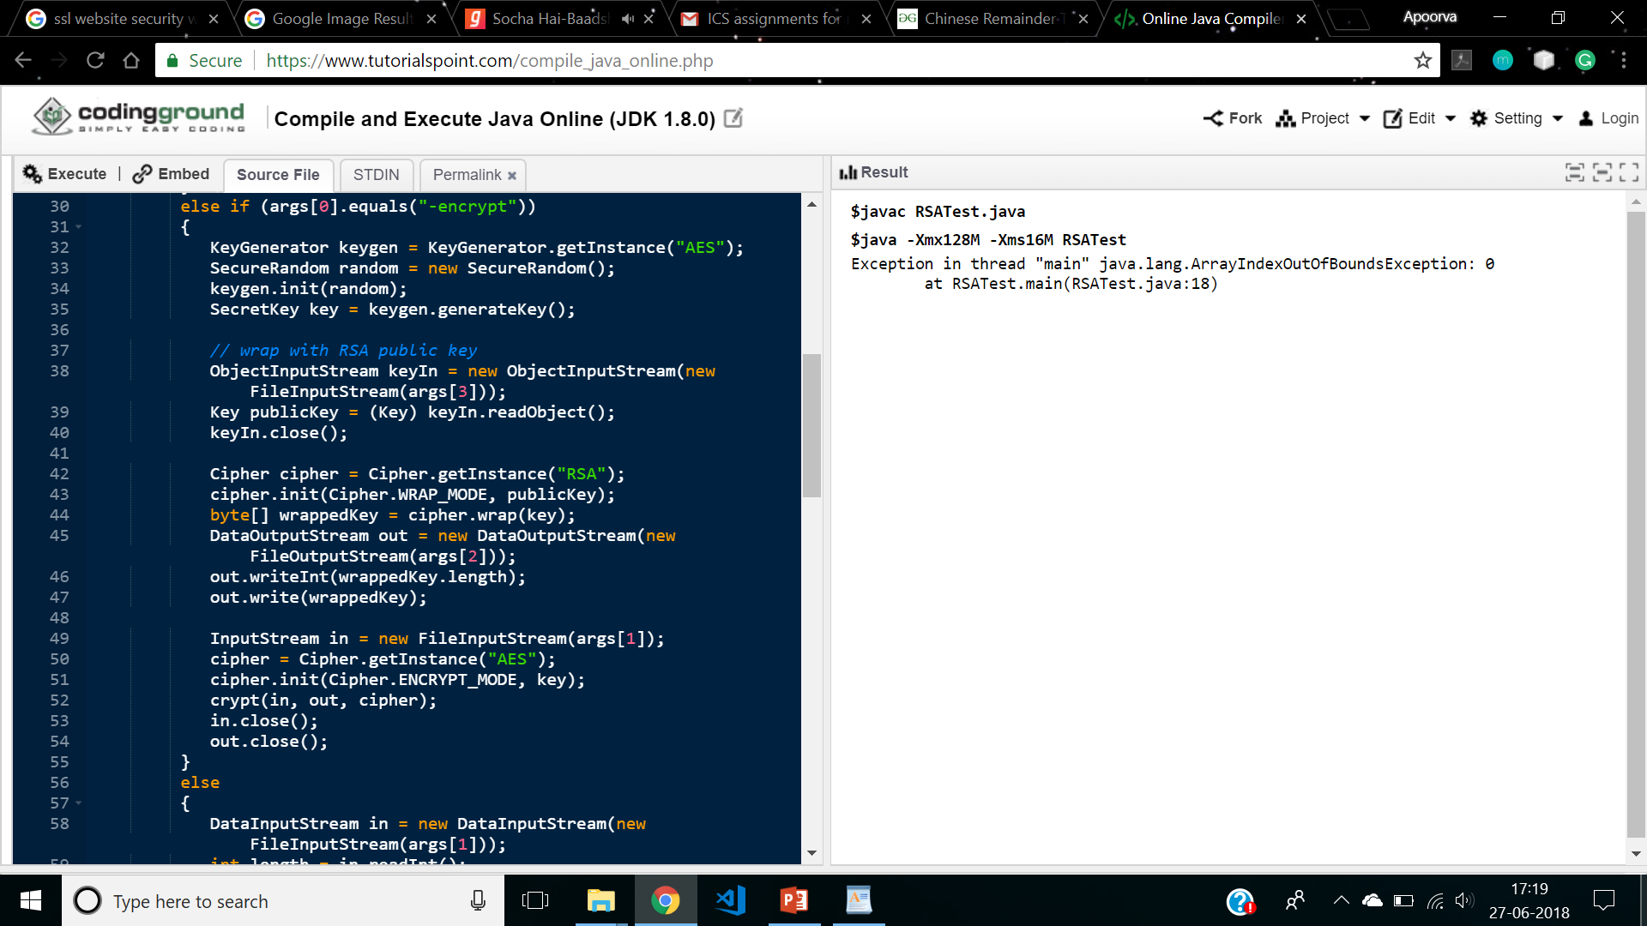

Slide 16
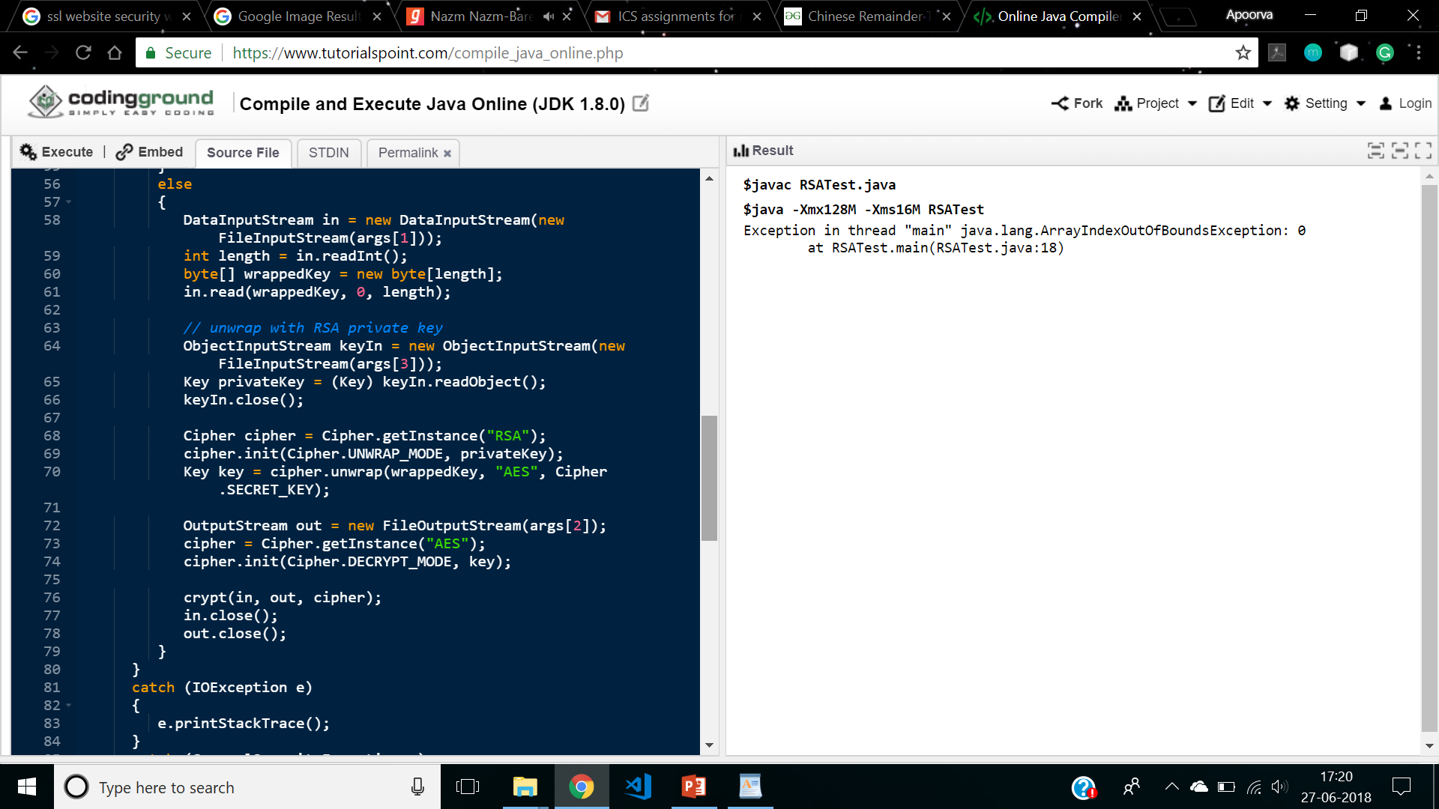

Slide 17
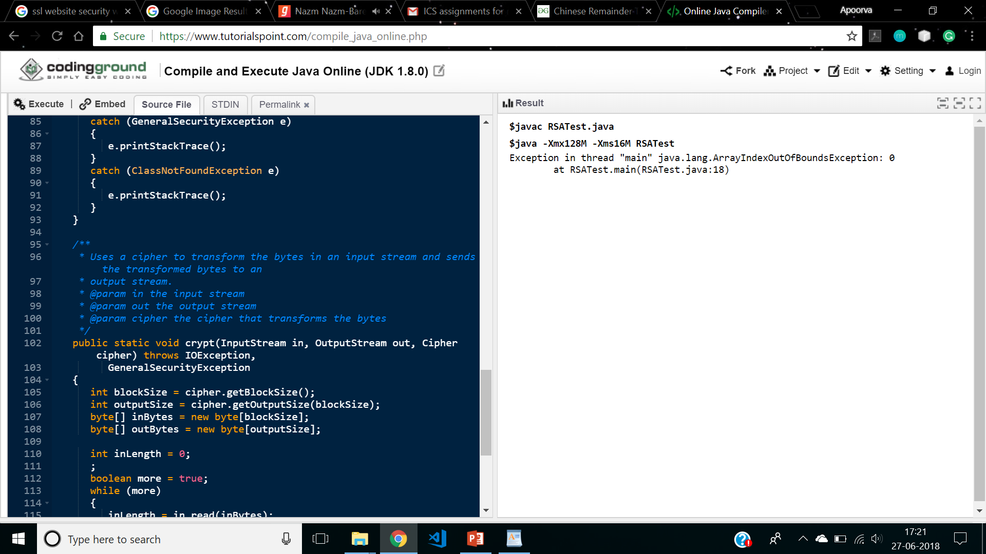

Slide 18
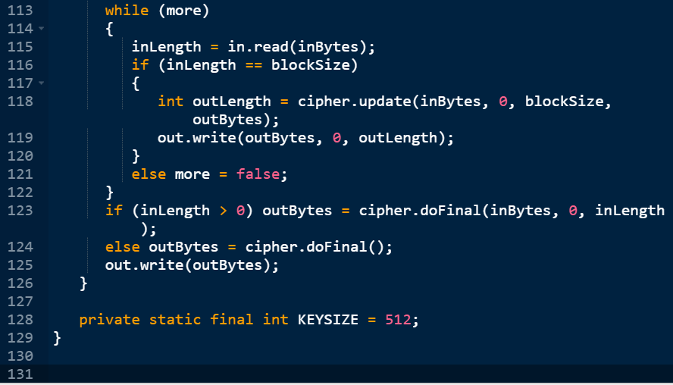

Slide 19
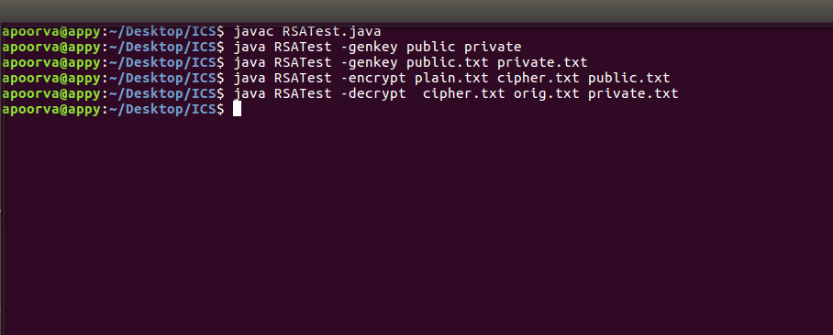
Output

Slide 20
Assignment 2
Develop and program in C++ or Java based on number theory such as Chinese remainder

Slide 21
Relative Prime Numbers
Two integers are termed relative prime if the only common factor between them is 1. i.e. Greatest Common Divisor(m, n) = 1
Any integer can be broken down into certain multiples of prime numbers. This is called prime factorization. When two integers are prime factorized and the only common number is 1, then the two integers are relative prime. Two distinct primes and are always relatively prime. Relative primality is not transitive.
Example
18 = 2 x 3 x 3
35 = 7 x 5
so 18 and 35 are relative primes.

Slide 22
Chinese Remainder Theorem
Let m1, m2, …, mk be pair wise relatively prime positive integers. That is, gcd(mi, mj) = 1 for 1£i<j £k.
Let aiÎZmi for 1£i £k and set M=m1m2…mk.
Then there exists a unique A ÎZm such that Aºai mod mi for i = 1…k.
A can be computed as:
where for 1 ≤ i ≤ k.

Slide 23
Steps in Chinese Remainder Theorem
Find M = m1 × m2 × … × mk. This is the common modulus.
Find M1 = M/m1, M2 = M/m2… Mk = M/mk.
Find the multiplicative inverse of M1, M2, …, Mk using the corresponding moduli (m1, m2, …, mk). Call the inverses M1⁻¹, M2⁻¹, …, Mk ⁻¹.
The solution to the simultaneous equations is

Slide 24
Example
Find x for the following equations:
x ≡2 mod 3
x ≡ 3 mod 5
x ≡ 2 mod 7
Answer:
M = 3 × 5 × 7 = 105
M1 = 105 / 3 = 35, M2 = 105 / 5 = 21, M3 = 105 / 7 = 15
The inverses are M1−1 = 2, M2−1 = 1, M3 −1 = 1
x = (2 × 35 × 2 + 3 × 21 × 1 + 2 × 15 × 1) mod 105 = 23 mod 105
x = 23

Slide 25
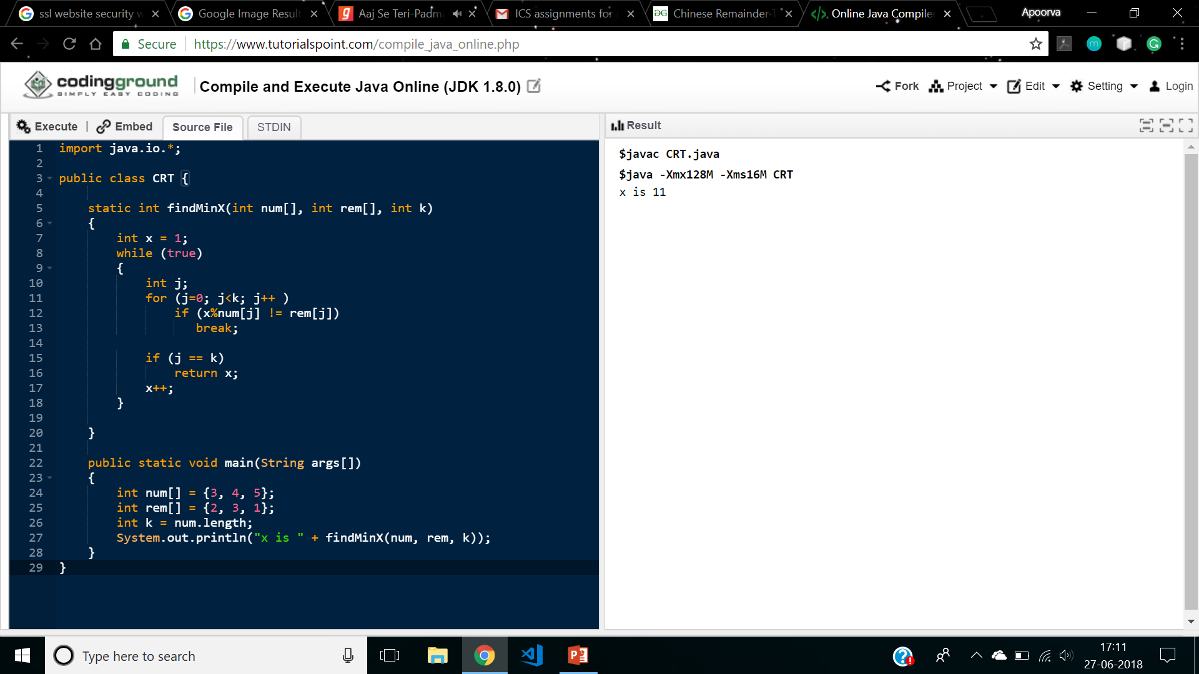
Code

Slide 26
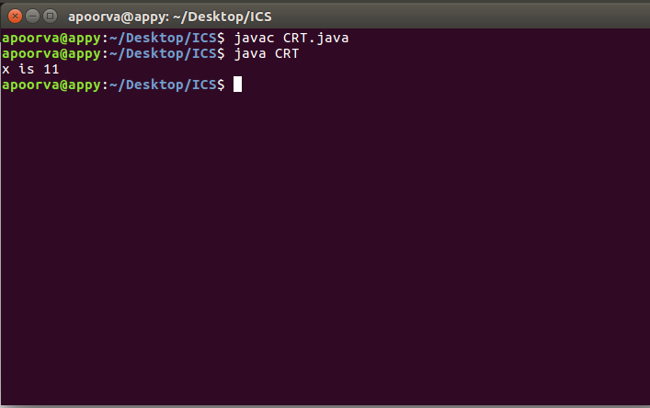
Output

Slide 27
Assignment 3
Write a program in C++ or Java to implement SHA1 algorithm using libraries (API)

Slide 28
Secure Hash Algorithm (SHA)
The National Institute of Standard and Technology(NIST) along with NSA developed the Secure Hash Algorithm(SHA).SHA works with any input message that is less than 2⁶⁴ bits in length. The output of SHA-1 is a message digest which is 160 bits in length.
The word secure is SHA was decided based on two features. SHA is designed to be computationally infeasible to:
1. Obtain the original message, given its message digest and
2. Find two messages producing the same message digest

Slide 29
Comparison of SHA parameters

Slide 30
Steps for SHA
Padding
The first step in SHA is to add padding to the end of the original message in such a way that the length of the message is 64 bits short of multiple of 512.Padding is always added even if message is already 64 bit short of multiple of 512.
Append length
The length of the message excluding the length of the padding is now calculated and appended to the end of the padding as a 64 bit block.

Slide 31
Steps for SHA (cntd)
Divide the input into 512 bit block
The input message is now divided into blocks, each of length 512 bits. These blocks become the input to the message digest processing logic.
Initialize chaining variables
Five chaining variables A through E are initializes. Each chaining variable is 32 bits in length. Following table shows their values
Variable Name | Value(in Hexadecimal)
A | 01 23 45 67
B | 89 AB CD EF
C | FE DC BA 98
D | 76 54 32 10
E | C3 D2 E1 F0

Slide 32
Steps for SHA (cntd)
Process Block
This process is divided into following sub steps
Step 5.1
Copy the chaining variables –E into variables a-e. The combination of a-e called abcde will be considered as a single register for storing the temporary intermediate as well as the final results.
Step 5.2
Now divide the current 512 bit block into 16 sub blocks, each consisting of 32 bits.

Slide 33
Steps for SHA (cntd)
Step 5.3
SHA has 4 rounds each consisting of 20 steps or iteration. Each round takes the current 512 bit block, the register abcde and a constant K[t] (where t=0 to 79) as the three inputs. It then updates the contents of the register abcde using SHA algorithm steps. We have only four constants defined for K[t],one used in each of four rounds. The values of K[t] are given in following table:
Round | Value of t between | K[t](in Hexadecimal)
1 | 1 and 19 | 5A 92 79 99
2 | 20 and 39 | 6E D9 EB A1
3 | 40 and 59 | 9F 1B BC DC
4 | 60 and 79 | CA 62 C1 D6

Slide 34
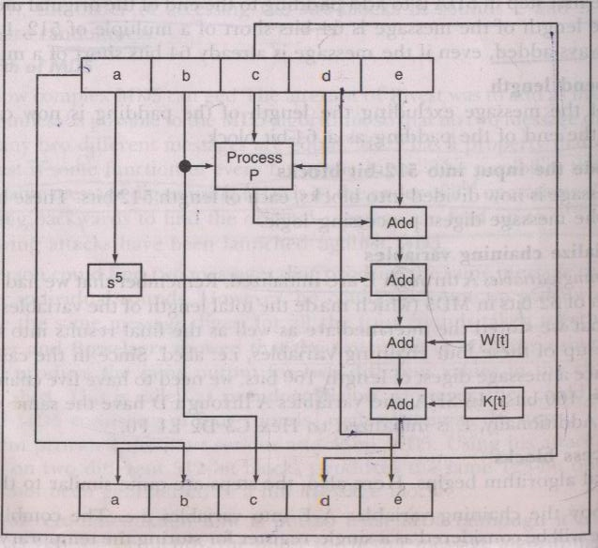
Steps for SHA (cntd)
Step 5.4
SHA consist of four rounds, each round containing 20 iterations. This makes a total of 80 iterations. The logical operation of SHA-1 is shown as follows:

Slide 35
Steps for SHA (cntd)
Mathematically iteration consists of following operations
abcde =(e + Process P +s⁵ (a) + W[t] + K[t]),a,s³⁰ (b),c, d
where abcde =The register made up of five variables a, b, c, d, e
process P=The logical operation ,which is given in following table
s^{t} =Circular left shift of 32 bit sub block by t bits.
W[t]=A 32 bit value derived from current 32 bit sub block
K[t]=one of the constant defined earlier

Slide 36
Steps for SHA (cntd)
Process P is given as
Round | Process P
1 | (b AND c) OR ((NOT b) AND (d))
2 | b XOR c XOR d
3 | (b AND c) OR (b AND d) OR (c AND d)
4 | B XOR c XOR d

Slide 37
Steps for SHA (cntd)
Value of W[t] is calculated as follow
For the first 16 blocks of W( i.e t=0 to 15) the contents of the inpu message sub block M[t] become the content of W[t]. Remaining values are calculated as
For t=0 to 15 | Value of W[t]
W[t]= | Same as M[t]
W[t]= | (W[t -16] XOR W[t-14] XOR W[t-8] XOR W[t-3])

Slide 38
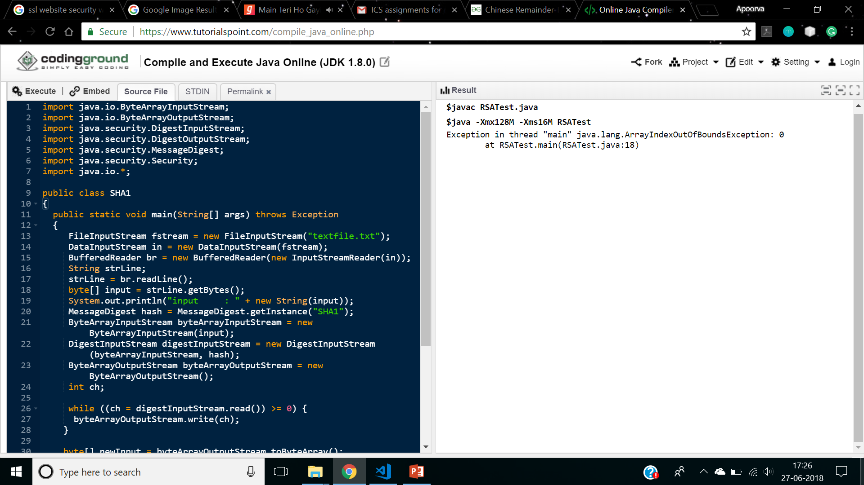
Code

Slide 39
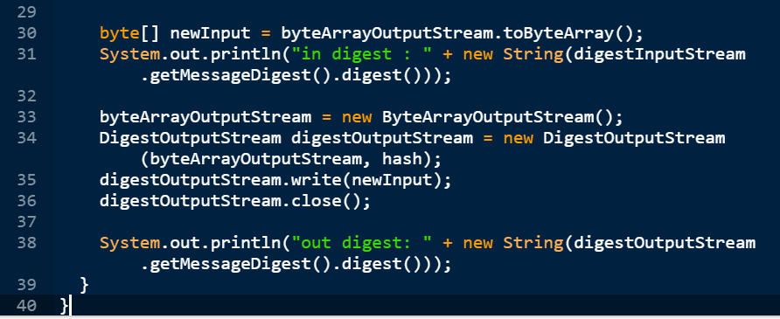

Slide 40
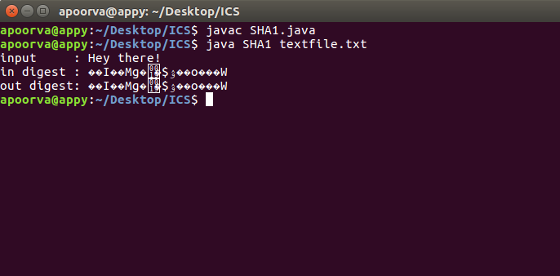
Output

Slide 41
Assignment 4
Configure and demonstrate use of vulnerability assessment tool such as Snort tool for intrusion or SSL Web security

Slide 42

Snort
Snort is a popular choice for running a network intrusion detection systems or NIDS for short. It monitors the package data sent and received through a specific network interface.
NIDS can catch threats targeting your system vulnerabilities using signature-based detection and protocol analysis technologies. NIDS software, when installed and configured appropriately, can identify the latest attacks, malware infections, compromised systems, and network policy violations.

Slide 43
Install SNORT on Ubuntu 16.04
Preparing your server
Setting up a basic configuration of Snort on Ubuntu is fairly simple but takes a few steps to complete. You will first need to install all the prerequisite software to ready your cloud server for installing Snort itself. Install the required libraries with the following command.
sudo apt install -y gcc libpcre3-dev zlib1g-dev libpcap-dev openssl libssl-dev libnghttp2-dev libdumbnet-dev bison flex libdnet

Slide 44
Install SNORT on Ubuntu 16.04 (cntd)
Installing from the source
Setting up Snort on Ubuntu from the source code consists of a couple of steps: downloading the code, configuring it, compiling the code, installing it to an appropriate directory, and lastly configuring the detection rules.
Start by making a temporary download folder to your home directory and then changing into it with the command below.
mkdir ~/snort_src && cd ~/snort_src

Slide 45
Install SNORT on Ubuntu 16.04 (cntd)
Snort itself uses something called Data Acquisition library (DAQ) to make abstract calls to packet capture libraries. Download the latest DAQ source package from the Snort website with the wget command underneath. Replace the version number in the command if a newer source available.
The download will only take a few seconds. When complete, extract the source code and jump into the new directory with the following commands.
wget https://www.snort.org/downloads/snort/daq-2.0.6.tar.gz
tar -xvzf daq-2.0.6.tar.gz
cd daq-2.0.6

Slide 46
Install SNORT on Ubuntu 16.04 (cntd)
Run the configuration script using its default values, then compile the program with make and finally install DAQ.
With the DAQ installed you can get started with Snort, change back to the download folder.
./configure && make && sudo make install
cd ~/snort_src

Slide 47
Install SNORT on Ubuntu 16.04 (cntd)
Next, download the Snort code with wget. You can find the latest version number on the Snort download page. Replace in the command if necessary.
Once the download is complete, extract the source and change into the new directory with these commands.
wget https://www.snort.org/downloads/snort/snort-2.9.11.1.tar.gz
tar -xvzf snort-2.9.11.1.tar.gz
cd snort-2.9.11.1

Slide 48
Install SNORT on Ubuntu 16.04 (cntd)
Then configure the installation with sourcefile enabled, run make and make install.
With that done, continue below on how to set up the configuration files.
./configure --enable-sourcefire && make && sudo make install

Slide 49
Install SNORT on Ubuntu 16.04 (cntd)
Configuring Snort to run in NIDS mode
Next, you will need to configure Snort for your system. This includes editing some configuration files, downloading the rules that Snort will follow, and taking Snort for a test run.
Start with updating the shared libraries using the command underneath
Snort on Ubuntu gets installed to /usr/local/bin/snort directory. It is a good practice to create a symbolic link to /usr/sbin/snort.
sudo ldconfig
sudo ln -s /usr/local/bin/snort /usr/sbin/snort

Slide 50
Install SNORT on Ubuntu 16.04 (cntd)
Setting up username and folder structure
To run Snort on Ubuntu safely without root access, you should create a new unprivileged user and a new user group for the daemon to run under.
sudo groupadd snort
sudo useradd snort -r -s /sbin/nologin -c SNORT_IDS -g snort

Slide 51
Install SNORT on Ubuntu 16.04 (cntd)
Then create the folder structure to house the Snort configuration, just copy over the commands below.
sudo mkdir -p /etc/snort/rules
sudo mkdir /var/log/snort
sudo mkdir /usr/local/lib/snort_dynamicrules

Slide 52
Install SNORT on Ubuntu 16.04 (cntd)
Set the permissions for the new directories accordingly.
sudo chmod -R 5775 /etc/snort
sudo chmod -R 5775 /var/log/snort
sudo chmod -R 5775 /usr/local/lib/snort_dynamicrules
sudo chown -R snort:snort /etc/snort
sudo chown -R snort:snort /var/log/snort
sudo chown -R snort:snort /usr/local/lib/snort_dynamicrules

Slide 53
Install SNORT on Ubuntu 16.04 (cntd)
Create new files for the white and blacklists as well as the local rules.
Then copy the configuration files from the download folder.
sudo touch /etc/snort/rules/white_list.rules
sudo touch /etc/snort/rules/black_list.rules
sudo touch /etc/snort/rules/local.rules
sudo cp ~/snort_src/snort-2.9.11.1/etc/*.conf* /etc/snort
sudo cp ~/snort_src/snort-2.9.11.1/etc/*.map /etc/snort

Slide 54
Install SNORT on Ubuntu 16.04 (cntd)
Next up, you will need to download the detection rules Snort will follow to identify potential threats. Snort provides three tiers of rule sets, community, registered and subscriber rules.
Community rules are freely available though slightly limited.
By registering for free on their website you get access to your Oink code, which lets you download the registered users rule sets.
Lastly, subscriber rules are just that, available to users with an active subscription to Snort services.

Slide 55
Install SNORT on Ubuntu 16.04 (cntd)
Instructions for downloading both community rules or registered user rule sets.
Option 1. Using community rules
If you just want to quickly test out Snort, grab the community rules using wget with the command below.
Extract the rules and copy them to your configuration folder.
wget https://www.snort.org/rules/community -O ~/community.tar.gz
sudo tar -xvf ~/community.tar.gz -C ~/
sudo cp ~/community-rules/* /etc/snort/rules

Slide 56
Install SNORT on Ubuntu 16.04 (cntd)
By default, Snort on Ubuntu expects to find a number of different rule files which are not included in the community rules. You can easily comment out the unnecessary lines using the sed command underneath.
sudo sed -i 's/include \$RULE\_PATH/#include \$RULE\_PATH/' /etc/snort/snort.conf

Slide 57
Install SNORT on Ubuntu 16.04 (cntd)
Option 2. Obtaining registered user rules
You can also take a moment and register on the Snort website. Registering gives you access to use their Oink code to download the registered user rules. You can find the code in the Snort user account details.
Replace the <oinkcode> in the following command with your personal code.
Once downloaded, extract the rules over to your configuration directory.
wget https://www.snort.org/rules/snortrules-snapshot-29111.tar.gz?oinkcode=<oinkcode> -O ~/registered.tar.gz
sudo tar -xvf ~/registered.tar.gz -C /etc/snort

Slide 58
Install SNORT on Ubuntu 16.04 (cntd)
The rule sets for the registered users include an extensive amount of useful preconfigured detection rules. If you tried out Snort with the community rules first, you can enable additional rules by uncommenting their inclusions towards the end of the snort.conf file.

Slide 59
Install SNORT on Ubuntu 16.04 (cntd)
Configuring the network and rule sets
With the configuration and rule files in place, edit the snort.conf to modify a few parameters. Open the configuration file in your favorite text editor, for example using nanowith the command below.
Find these sections shown below in the configuration file and change the parameters to reflect the examples here.
sudo nano /etc/snort/snort.conf

Slide 60
Install SNORT on Ubuntu 16.04 (cntd)
# Setup the network addresses you are protecting
ipvar HOME_NET <server public IP>/32
# Set up the external network addresses. Leave as "any" in most situations
ipvar EXTERNAL_NET !$HOME_NET
# Path to your rules files (this can be a relative path)
var RULE_PATH /etc/snort/rules
var SO_RULE_PATH /etc/snort/so_rules
var PREPROC_RULE_PATH /etc/snort/preproc_rules
# Set the absolute path appropriately
var WHITE_LIST_PATH /etc/snort/rules
var BLACK_LIST_PATH /etc/snort/rules

Slide 61
Install SNORT on Ubuntu 16.04 (cntd)
In the same snort.conf file, scroll down to the section 6 and set the output for unified2 to log under filename of snort.log like below.
Lastly, scroll down towards the bottom of the file to find the list of included rule sets. You will need to uncomment the local.rules to allow Snort to load any custom rules.
# unified2
# Recommended for most installs
output unified2: filename snort.log, limit 128
include $RULE_PATH/local.rules

Slide 62
Install SNORT on Ubuntu 16.04 (cntd)
If you are using the community rules, add the line underneath to your ruleset as well, for example just below your local.rules line.
Once you are done with the configuration file, save the changes and exit the editor.
include $RULE_PATH/community.rules

Slide 63
Install SNORT on Ubuntu 16.04 (cntd)
Validating settings
Your Snort should now be ready to run. Test the configuration using the parameter -T to enable test mode.
After running the Snort configuration test, you should get a message like this example below.
sudo snort -T -c /etc/snort/snort.conf

Slide 64
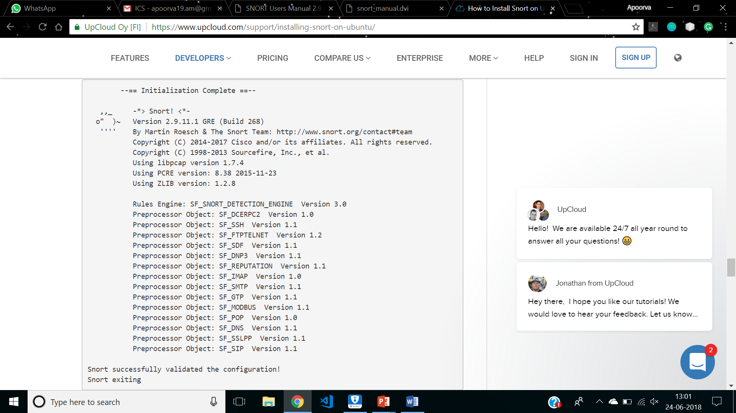

Slide 65
Install SNORT on Ubuntu 16.04 (cntd)
In case you get an error, the print out should tell you what the problem was and where to fix it. Most likely problems are missing files or folders, which you can usually resolve by either adding any you might have missed in the setup above, or by commenting out unnecessary inclusion lines in the snort.conf file. Check the configuration part and try again.

Slide 66
Install SNORT on Ubuntu 16.04 (cntd)
Testing the configuration
To test if Snort is logging alerts as intended, add a custom detection rule alert on incoming ICMP connections to the local.rules file. Open your local rules in a text editor.
Then add the following line to the file.
sudo nano /etc/snort/rules/local.rules
alert icmp any any -> $HOME_NET any (msg:"ICMP test"; sid:10000001; rev:001;)

Slide 67
Install SNORT on Ubuntu 16.04 (cntd)
The rule consists of the following parts:
action for traffic matching the rule, alert in this case
traffic protocol like TCP, UDP or ICMP like here
the source address and port, simply marked as any to include all addresses and ports
the destination address and port, $HOME_NET as declared in the configuration and any for port
some additional bits
log message
unique rule identifier (sid) which for local rules needs to be 1000001 or higher
rule version number.
Save the local.rules and exit the editor.

Slide 68
Install SNORT on Ubuntu 16.04 (cntd)
Start Snort with -A console options to print the alerts to stdout. You will need to select the correct network interface with the public IP address of your server, for example, eth0.
If you are not sure which interface to use, check your UpCloud Control Panel for the public IPv4 address of your server in the Network settings. You can also use the following command on your server.
sudo snort -A console -i eth0 -u snort -g snort -c /etc/snort/snort.conf
ip addr

Slide 69
Install SNORT on Ubuntu 16.04 (cntd)
The output will list all of your currently configured network interfaces. Find the one with the same public IP address as shown in the Network settings, commonly eth0.
With Snort up and running, ping your cloud server from any other computer. You should see a notice for each ICMP call in the terminal running Snort.
After the alerts show up you can stop Snort with ctrl+C.
07/12-11:20:33.501624 [**] [1:10000001:1] ICMP test [**] [Priority: 0] {ICMP} 83.136.252.119 -> 80.69.173.202

Slide 70
Install SNORT on Ubuntu 16.04 (cntd)
Snort records the alerts to a log under /var/log/snort/snort.log.<timestamp>, where the time stamp is the point in time when Snort was started marked in Unix time. You can read the logs with the command underneath. Since you have only run Snort once, there is only one log, complete your command by pressing TAB.
The log shows a warning for each ICMP call with source and destination IPs, time and date, plus some additional info as shown in the example below.
snort -r /var/log/snort/snort.log.
WARNING: No preprocessors configured for policy 0.
07/12-11:20:33.501624 83.136.252.119 -> 80.69.173.202
ICMP TTL:63 TOS:0x0 ID:20187 IpLen:20 DgmLen:84 DF
Type:8 Code:0 ID:13891 Seq:1 ECHO

Slide 71
Install SNORT on Ubuntu 16.04 (cntd)
Running Snort in the background
To run Snort on Ubuntu as a service in the background you will need to add a startup script for Snort. Open a new a file in a text editor for example with the next command.
Enter the following to the file, save and exit the editor.
sudo nano /lib/systemd/system/snort.service

Slide 72
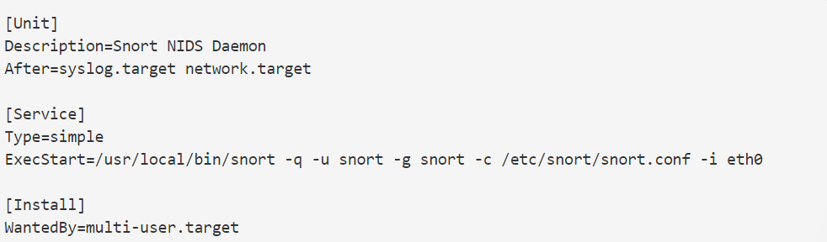
Install SNORT on Ubuntu 16.04 (cntd)
With the service defined, reload the systemctl daemon.
sudo systemctl daemon-reload

Slide 73
Install SNORT on Ubuntu 16.04 (cntd)
Snort can then be run with the configuration you set up using the command below.
The startup script also includes other usual systemctl commands: stop, restart, and status. For example, you can check the status of the service with the following command
You can also look up the tutorial on Installing snort on Ubuntu
sudo systemctl start snort
sudo systemctl status snort

Slide 74
SSL Website Security
SSL (Secure Sockets Layer) is a standard security protocol for establishing encrypted links between a web server and a browser in an online communication.
The usage of SSL technology ensures that all data transmitted between the web server and browser remains encrypted.
An SSL certificate is necessary to create SSL connection. You would need to give all details about the identity of your website and your company as and when you choose to activate SSL on your web server. Following this, two cryptographic keys are created - a Private Key and a Public Key.

Slide 75
The next step is the submission of the CSR (Certificate Signing Request), which is a data file that contains your details as well as your Public Key. The CA (Certification Authority) would then validate your details.
Following successful authentication of all details, you will be issued SSL certificate. The newly-issued SSL would be matched to your Private Key. From this point onwards, an encrypted link is established by your web server between your website and the customer's web browser.

Slide 76
On the apparent level, the presence of an SSL protocol and an encrypted session is indicated by the presence of the lock icon in the address bar.
A click on the lock icon displays to a user/customer details about your SSL. It's to be remembered that SSL Certificates are issued to either companies or legally accountable individuals only after proper authentication.

Slide 77
What is SSL used for?
The SSL protocol is used by millions of online business to protect their customers, ensuring their online transactions remain confidential.
A web page should use encryption when it expects users to submit confidential data, including personal information, passwords, or credit card details.
All web browsers have the ability to interact with secured sites so long as the site's certificate is issued by a trusted CA.

Slide 78
What is SSL/TLS Certificate?
SSL or TLS (Transport Layer Security) certificates are data files that bind a cryptographic key to the details of an organization. When SSL/TLS certificate is installed on a web server, it enables a secure connection between the web server and the browser that connects to it.
The website's URL is prefixed with "https" instead of "http" and a padlock is shown on the address bar. If the website uses an extended validation (EV) certificate, then the browser may also show a green address bar.
Whenever a browser initiates a connection with a SSL secured website , it will first retrieve the site's SSL Certificate to check if it's still valid. If any of these checks fail, a warning will be displayed to the user, indicating that the website is not secured by a valid SSL certificate.

Slide 79
Why does one need SSL certificate?
The internet has spawned new global business opportunities for enterprises conducting online commerce. However, that growth has also attracted fraudsters and cyber criminals who are ready to exploit any opportunity to steal consumer bank account numbers and card details.
Any moderately skilled hacker can easily intercept and read the traffic unless the connection between a client (e.g. internet browser) and a web server is encrypted.

Slide 80
Who issues SSL Certificates?
A certificate authority or certification authority (CA) issues SSL certificates. On receiving an application, the CA verifies two factors: It confirms the legal identity of the enterprise/company seeking the certificate and whether the applicant controls the domain mentioned in the certificate. The issued SSL certificates are chained to a 'trusted root' certificate owned by the CA.
Most popular internet browsers such as Firefox, Chrome, Internet Explorer, Microsoft Edge, and others have these root certificates embedded in their 'certificate store'. Only if a website certificate chains to a root in its certificate store will the browser allow a trusted and secure https connection. If a website certificate does not chain to a root then the browser will display a warning that the connection is not trusted.

Slide 81
Details included in SSL Certificate
SSL Certificates will contain details of whom the certificate has been issued to. This includes the domain name or common name, serial number; the details of the issuer; the period of validity - issue date and expiry date; SHA Fingerprints; subject public key algorithm, subject's public key; certificate signature algorithm, certificate signature value.
Other important details such as the type of certificate, SSL/TLS version, Perfect Forward Secrecy status, and cipher suite details are included. Organization validated and extended validation certificates also contain verified identity information about the owner of the website, including organization name, address, city, state and country.

Slide 82
Identify that a website uses SSL
A web page using SSL will display
"https://" instead of "http://" before the website's address in the browser's address bar
A padlock icon in the address bar of the browser before the address.
With an Extended Validation Certificate, the address bar also shows the registered name of the company that owns the website, the name of the issuing CA and, an additional green security indicator.

Slide 83
Working of SSL
An end-user asks their browser to make a secure connection to a website (e.g.https://www.example.com)
The browser obtains the IP address of the site from a DNS server then requests a secure connection to the website.
To initiate this secure connection, the browser requests that the server identifies itself by sending a copy of its SSL certificate to the browser.
The browser checks the certificate to ensure:
That it is signed by a trusted CA
That it is valid - that it has not expired or been revoked

Slide 84
That it confirms to required security standards on key lengths and other items.
That the domain listed on the certificate matches the domain that was requested by the user.
When the browser confirms that the website can be trusted, it creates a symmetric session key which it encrypts with the public key in the website's certificate. The session key is then sent to the web server.
The web server uses its private key to decrypt the symmetric session key.
The server sends back an acknowledgement that is encrypted with the session key.
From now on, all data transmitted between the server and the browser is encrypted and secure.

Slide 85
